Slide 1
Loop Control Structure
Unit-2 (Part-B)

Slide 2
Information
These slides are an overview and brief about the topic.
Take these slides as reference materials but you need to study more for better understanding.
Every topic couldn’t be covered due to time constraints.

Slide 3
Decision Making Statement
Decision making statement is depending on the condition block need to be executed or not which is decided by condition.
If the condition is "true" statement block will be executed, if condition is "false" then statement block will not be executed.
In C language there are three types of decision making statement.
if
if-else
switch

Slide 4
SWITCH statement
#include<stdio.h>
#include<conio.h>
void main() {
int ch;
clrscr();
printf("Enter any number (1 to 7)"); scanf("%d",&ch);
switch(ch)
{ case 1: printf("Today is Monday");
break;
case 2: printf("Today is Tuesday");
break;
case 3: printf("Today is Wednesday"); break;
case 4: printf("Today is Thursday"); break;
case 5: printf("Today is Friday"); break;
case 6: printf("Today is Saturday"); break;
case 7: printf("Today is Sunday"); break;
default: printf("Only enter value 1 to 7");
}
getch();
}
switch(ch)
{ case1:
statement 1;
break;
case2:
statement 2;
break;
}

Slide 5
Looping Statement in C
Looping statement are the statements execute one or more statement repeatedly several number of times. In C programming language there are three types of loops;
while,
for and
do-while.
Advantage with looping statement
Reduce length of Code
Take less memory space.
Burden on the developer is reducing.
Time consuming process to execute the program is reduced
Difference between conditional and looping statement
Conditional statement executes only once in the program where as looping statements executes repeatedly several number of time.

Slide 6
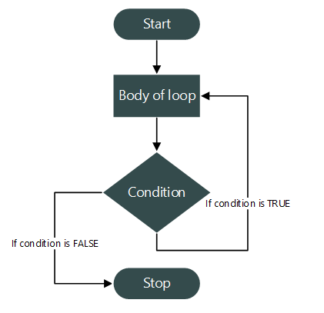
Flow chart of do while

Slide 7
/**
* C program to print natural numbers using do while loop
*/
#include <stdio.h>
int main()
{
/* Loop counter variable declaration */
int n=1;
do
{
/* Body of loop */
printf("%d ", n);
/* Update loop counter variable */
n++;
} while(n <= 10); /* Loop condition */
return 0;
}

